Slide 1
Library Lightning Round
Presenters:
Roseann Bowerman
Megan Fitzgibbons

Slide 2
Expanding Conversations About Information Literacy in the Curriculum: Faculty Guidance Using Focus Groups
Roseann Bowerman | November 4, 2009

Slide 3
FACULTY FOCUS GROUPS BY DISCIPLINE
Goal - Gather faculty insights and concerns on
Students’ information seeking habits and skills
Faculty expectations for their graduating majors
Did students possess the expected skills and knowledge?
Where in curriculum are or should these skills be acquired?

Slide 4
Organization and Process
Information Literacy Working Group
Facilitators
Director of Writing Across the Curriculum
Senior Instructional Technologist
11 Academic Departments
52 Teaching Faculty
Taping and “Debriefing” sessions
Developing achievable action plan

Slide 5
WHAT WE LEARNED
Student needs
Guidance on creating bibliographies
Discipline specific resource guides to increase knowledge of their “information environment.”
Awareness of librarian as resource mentor
International students’ special concerns
Faculty needs
Conversation within their departments on how students develop discipline specific information literacy
Familiarity with new tools and technologies

Slide 6
ACTION PLANS
TRAC Fellow Program
Peer mentors trained in writing, pedagogy, information literacy and instructional technology
Refworks
Bibliographic management and citation tool
LibGuides
Discipline specific guides to important resources using Web 2.0 features
International Student programming
Orientations, presentations, partnerships
Increased Outreach to research intensive classes

Slide 7
ACTION PLAN
Research Skills Assessment tool
Administer to rising Seniors
Expand to become a training tool as well
Offer additional training
Google Scholar
Refworks
New databases

Slide 8
Concept mapping for collaboration
Megan Fitzgibbons | November 4, 2009

Slide 9
…don’t always see eye to eye
Instructors
Librarians

Slide 10
Cmap + profs + info literacy

Slide 11
Uses of concept mapping
★ What are we doing and why?

Slide 12
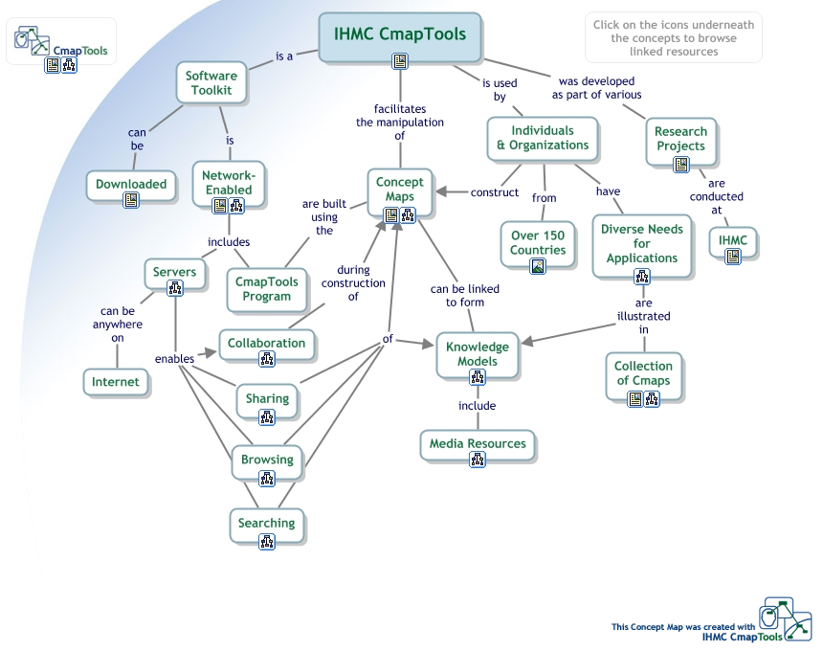
Download the program at
http://cmap.ihmc.us/conceptmap.html

Slide 14
Cmap + profs + info literacy
= Student learning

Slide 15
What did you think about this session?
Your input is important to us!
Click on “Evaluate This Session” on the conference program page.

